Slide 1



ENVIRONMENTAL HEALTH INTERVENTIONS FOR PREVENTATIVE PRACTICE IN CLINICAL SETTINGS
BY MISS A. BUKHOSINI
GROWING KWAZULU-NATAL TOGETHER

Slide 2

GROWING KWAZULU-NATAL TOGETHER
LEARNING OUTCOMES
Define environmental health within clinical settings.
Background to Environmental Health in Clinical Settings
Describing the role of an EHP in public health facilities
Core preventative interventions of EHPs in public health facilities
Environmental Health and Preventative Practice
Legislative Framework Guiding EHPs
Water Quality in Healthcare Facilities
Sanitation and Hygiene Controls
Infection Prevention and Environmental Hygiene
Environmental Health Audits and Inspections
2

Slide 3
GROWING KWAZULU-NATAL TOGETHER
INTRODUCTION
Environmental health is equals to the conditions in the clinical environment that influence patients and staff wellbeing in the clinical setting
Environmental health is a vital component that focuses on preventative practice which aims to eliminate or reduce environmental risks in the clinical setting
It focuses on identifying and mitigating environmental factors that can adversely affect health
Integration of environmental health into clinical setting enhances patients' safety, infection prevention and sustainable healthcare delivery.
3

Slide 4
BACKGROUND TO ENVIRONMENTAL HEALTH IN CLINICAL SETTINGS
Healthcare facilities are high-risk environments for disease transmission
Patients often have compromised immunity
Environmental conditions directly influence clinical outcomes
Preventative environmental health reduces avoidable healthcare-associated infections (HAIs)

Slide 5
GROWING KWAZULU-NATAL TOGETHER
THE ROLE OF AN EHP IN CLINICAL PRACTICE
Ensure safety and hygiene in a healthcare environment.
Supports clinical programs in the healthcare facility
Collaboration with public health(form part of various committees in a healthcare facility)
Monitor compliance with environmental health regulations and standards
Conducts EH awareness & trainings
Conduct audits to monitor compliance
Develop Standards operating procedures(SOPs) and guidelines relating to Environmental Health
5

Slide 6
GROWING KWAZULU-NATAL TOGETHER
ENVIRONMENTAL HEALTH INTERVENTIONS
Waste Management
- Safe and proper waste segregation, storage,
treatment
and disposal of healthcare waste
- Prevention of disease transmission through
contaminated waste
Water Quality Monitoring
- Ensuring potable water supply within healthcare facilities.
- Routine testing for microbial and chemical contaminants
Sanitation and hygiene
- Maintenance of clean ablution facilities and
handwashing stations
6

Slide 7
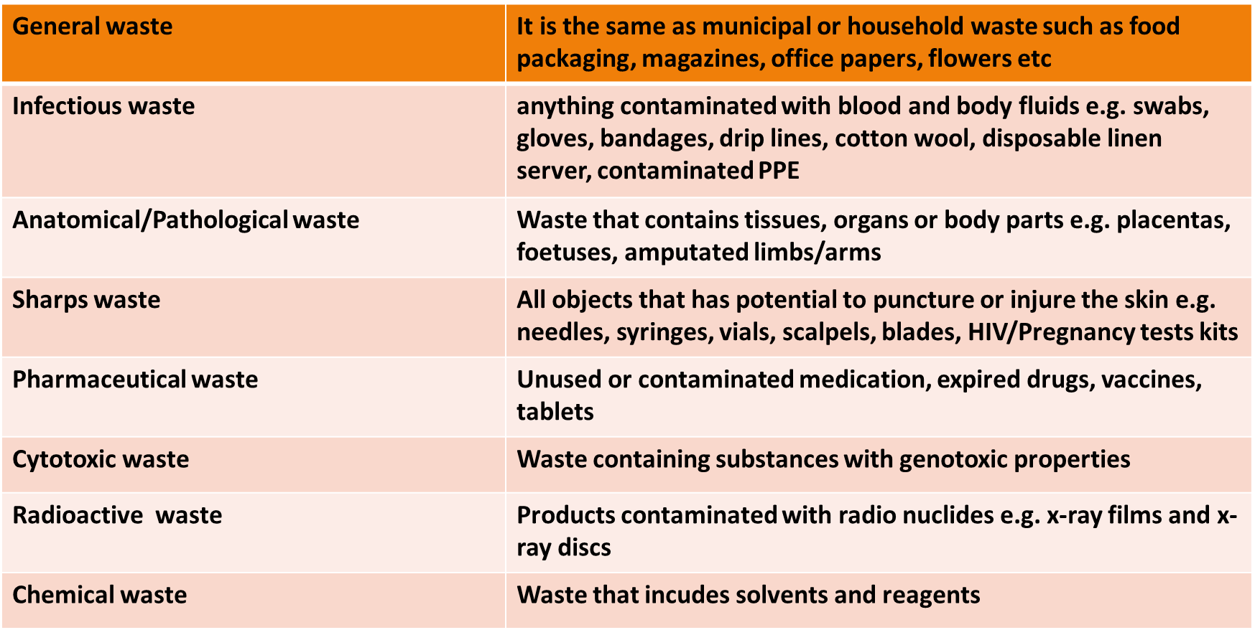

HEALTHCARE WASTE CATERGORIES

Slide 8
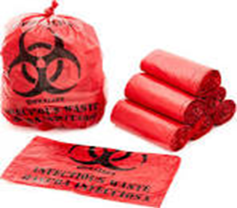
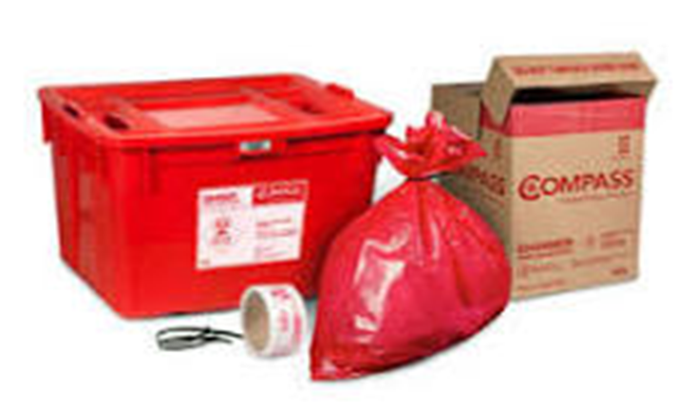
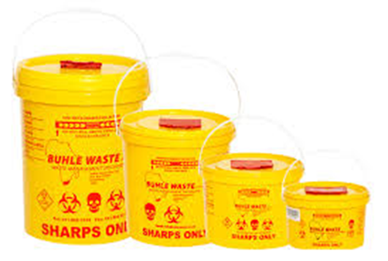
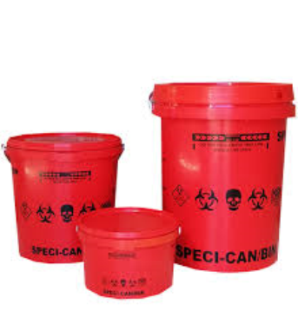
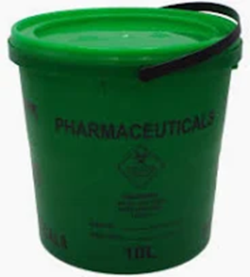
HEALTHCARE WASTE COULOUR CODES

Slide 9
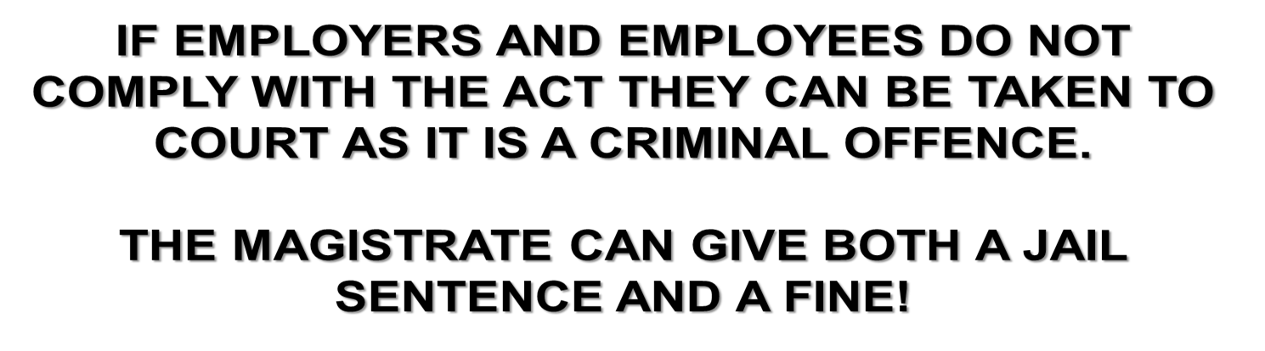


Slide 10
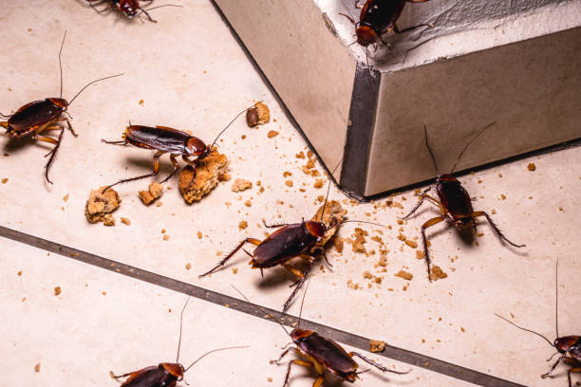
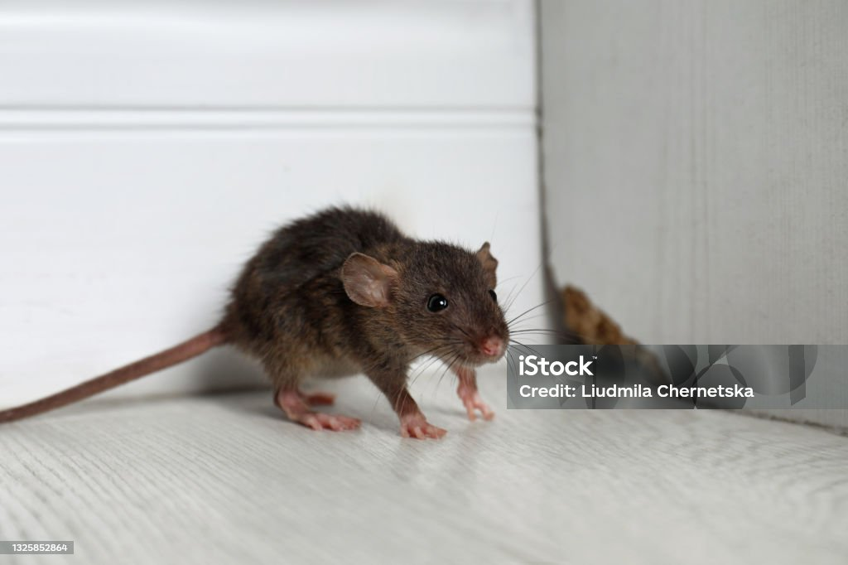
GROWING KWAZULU-NATAL TOGETHER
ENVIRONMENTAL HEALTH INTERVENTIONS
Vector control monitoring
Pest control & vector surveillance to prevent the spread of diseases
10

Slide 11


ENVIRONMENTAL HEALTH INTERVENTIONS
Food safety
Monitoring hospital kitchens and food service areas to prevent foodborne illnesses

Slide 12
ENVIRONMENTAL HEALTH AND PREVENTATIVE PRACTICE
Preventative practice focuses on risk reduction before illness occurs
Environmental Health Practitioners (EHPs) act proactively rather than reactively
Supports primary, secondary, and tertiary prevention
Aligns with National Health Act and Ideal Clinic Framework (SA)

Slide 13
LEGISLATIVE FRAMEWORK GUIDING EHPS
National Health Act (Act 61 of 2003)
Occupational Health and Safety Act
Environmental Health Norms and Standards
Municipal by-laws and provincial regulations

Slide 14
WATER QUALITY IN HEALTHCARE FACILITIES
Safe water is essential for infection prevention
Used for drinking, cleaning, sterilisation, and hygiene
Routine microbiological and chemical testing
Monitoring storage tanks and plumbing systems

Slide 15
SANITATION AND HYGIENE CONTROLS
Clean and functional toilets and ablution blocks
Adequate handwashing stations with soap
Availability of alcohol-based hand rubs
Routine cleaning schedules and monitoring

Slide 16
INFECTION PREVENTION AND ENVIRONMENTAL HYGIENE
Environmental cleaning reduces pathogen load
High-touch surfaces require frequent disinfection
Supports clinical infection prevention programs
Collaboration with IPC nurses and clinicians

Slide 17
ENVIRONMENTAL HEALTH AUDITS AND INSPECTIONS
Routine inspections identify risks early
Use of checklists and compliance tools
Documentation and corrective action plans
Supports continuous quality improvement

Slide 18
TRAINING AND AWARENESS PROGRAMMES
Environmental health education for staff
Waste segregation training
Hand hygiene promotion
Food safety and cleaning protocols

Slide 19
CHALLENGES IN CLINICAL ENVIRONMENTAL HEALTH
Limited resources and infrastructure
Staff shortages and high workload
Non-compliance with procedures
Need for continuous training

Slide 20
BENEFITS OF STRONG ENVIRONMENTAL HEALTH SYSTEMS
Reduced healthcare-associated infections
Improved patient safety and outcomes
Protection of healthcare workers
Enhanced public trust in healthcare services

Slide 21
ENVIRONMENTAL HEALTH AND SUSTAINABLE HEALTHCARE
Waste minimisation and recycling
Safe chemical management
Water and energy efficiency
Environmentally responsible healthcare delivery

Slide 22
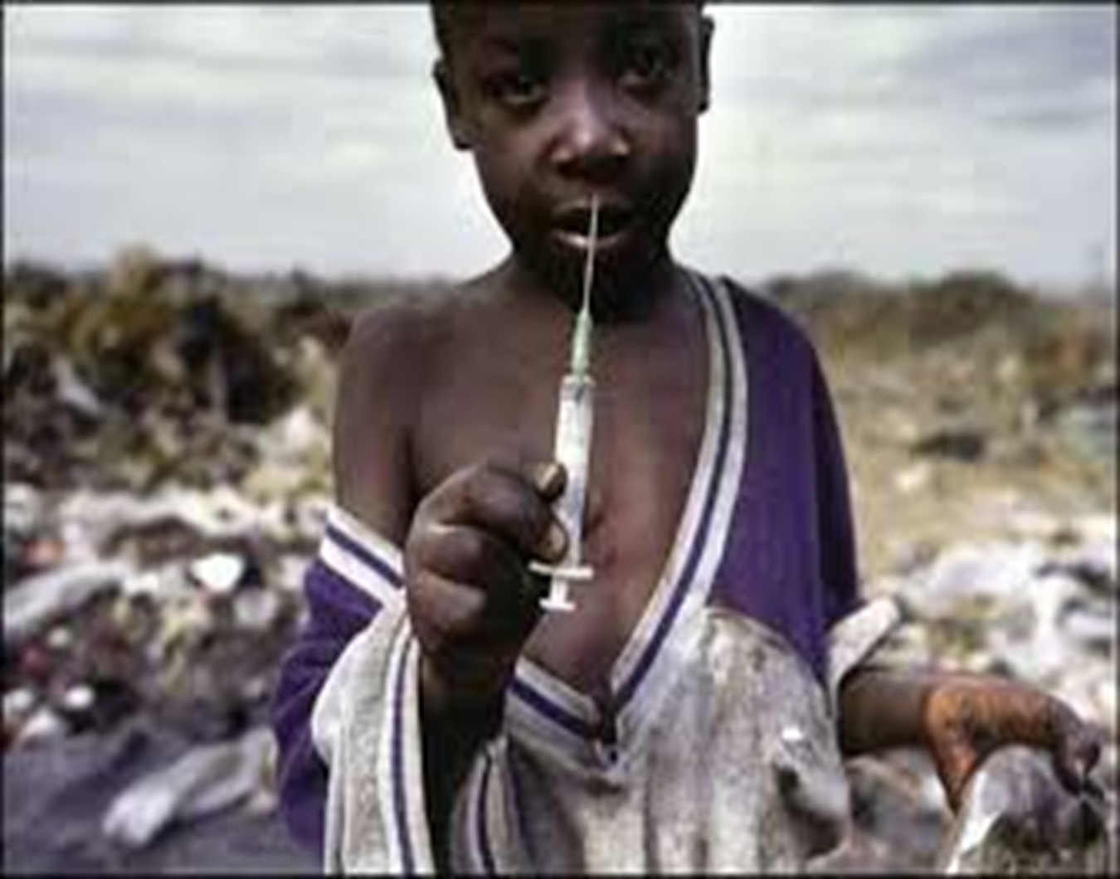
CASE EXAMPLE: PREVENTATIVE INTERVENTION IMPACT
Improved waste segregation reduces needle-stick injuries.
Enhanced cleaning lowers infection outbreaks
Safe food handling prevents patient illness
Water monitoring prevents diarrhoeal diseases

Slide 23
CONCLUSION
Environmental health in a healthcare setting is essential for preventing infections, protecting patients and staff and ensuring a safe, clean and supportive healing environment which supports wellbeing of everyone in a healthcare setting.

Slide 24
KEY TAKE-HOME MESSAGES
Environmental health is integral to clinical care
Prevention is more cost-effective than treatment
EHPs play a critical multidisciplinary role
Safe environments support healing and wellbeing

Slide 25


THANK YOU

